Slide 1
COLLEGE OF SCIENCE
CHM101
Chapter 1:
Atom & Electronic Configuration
Semister 1 (2018-2019)
Lecturers:
1- Dr. Faris A. J. Aldoghachi
2- Dr. Mohammed Alassadi

Slide 2
CHEMISTRY
Science
Branches of Chemistry:
1- Organic chemistry
2- Inorganic chemistry
3- Physical chemistry
4- Analytical chemistry
5- Biochemistry chemistry
6- Theoretical chemistry

Slide 3
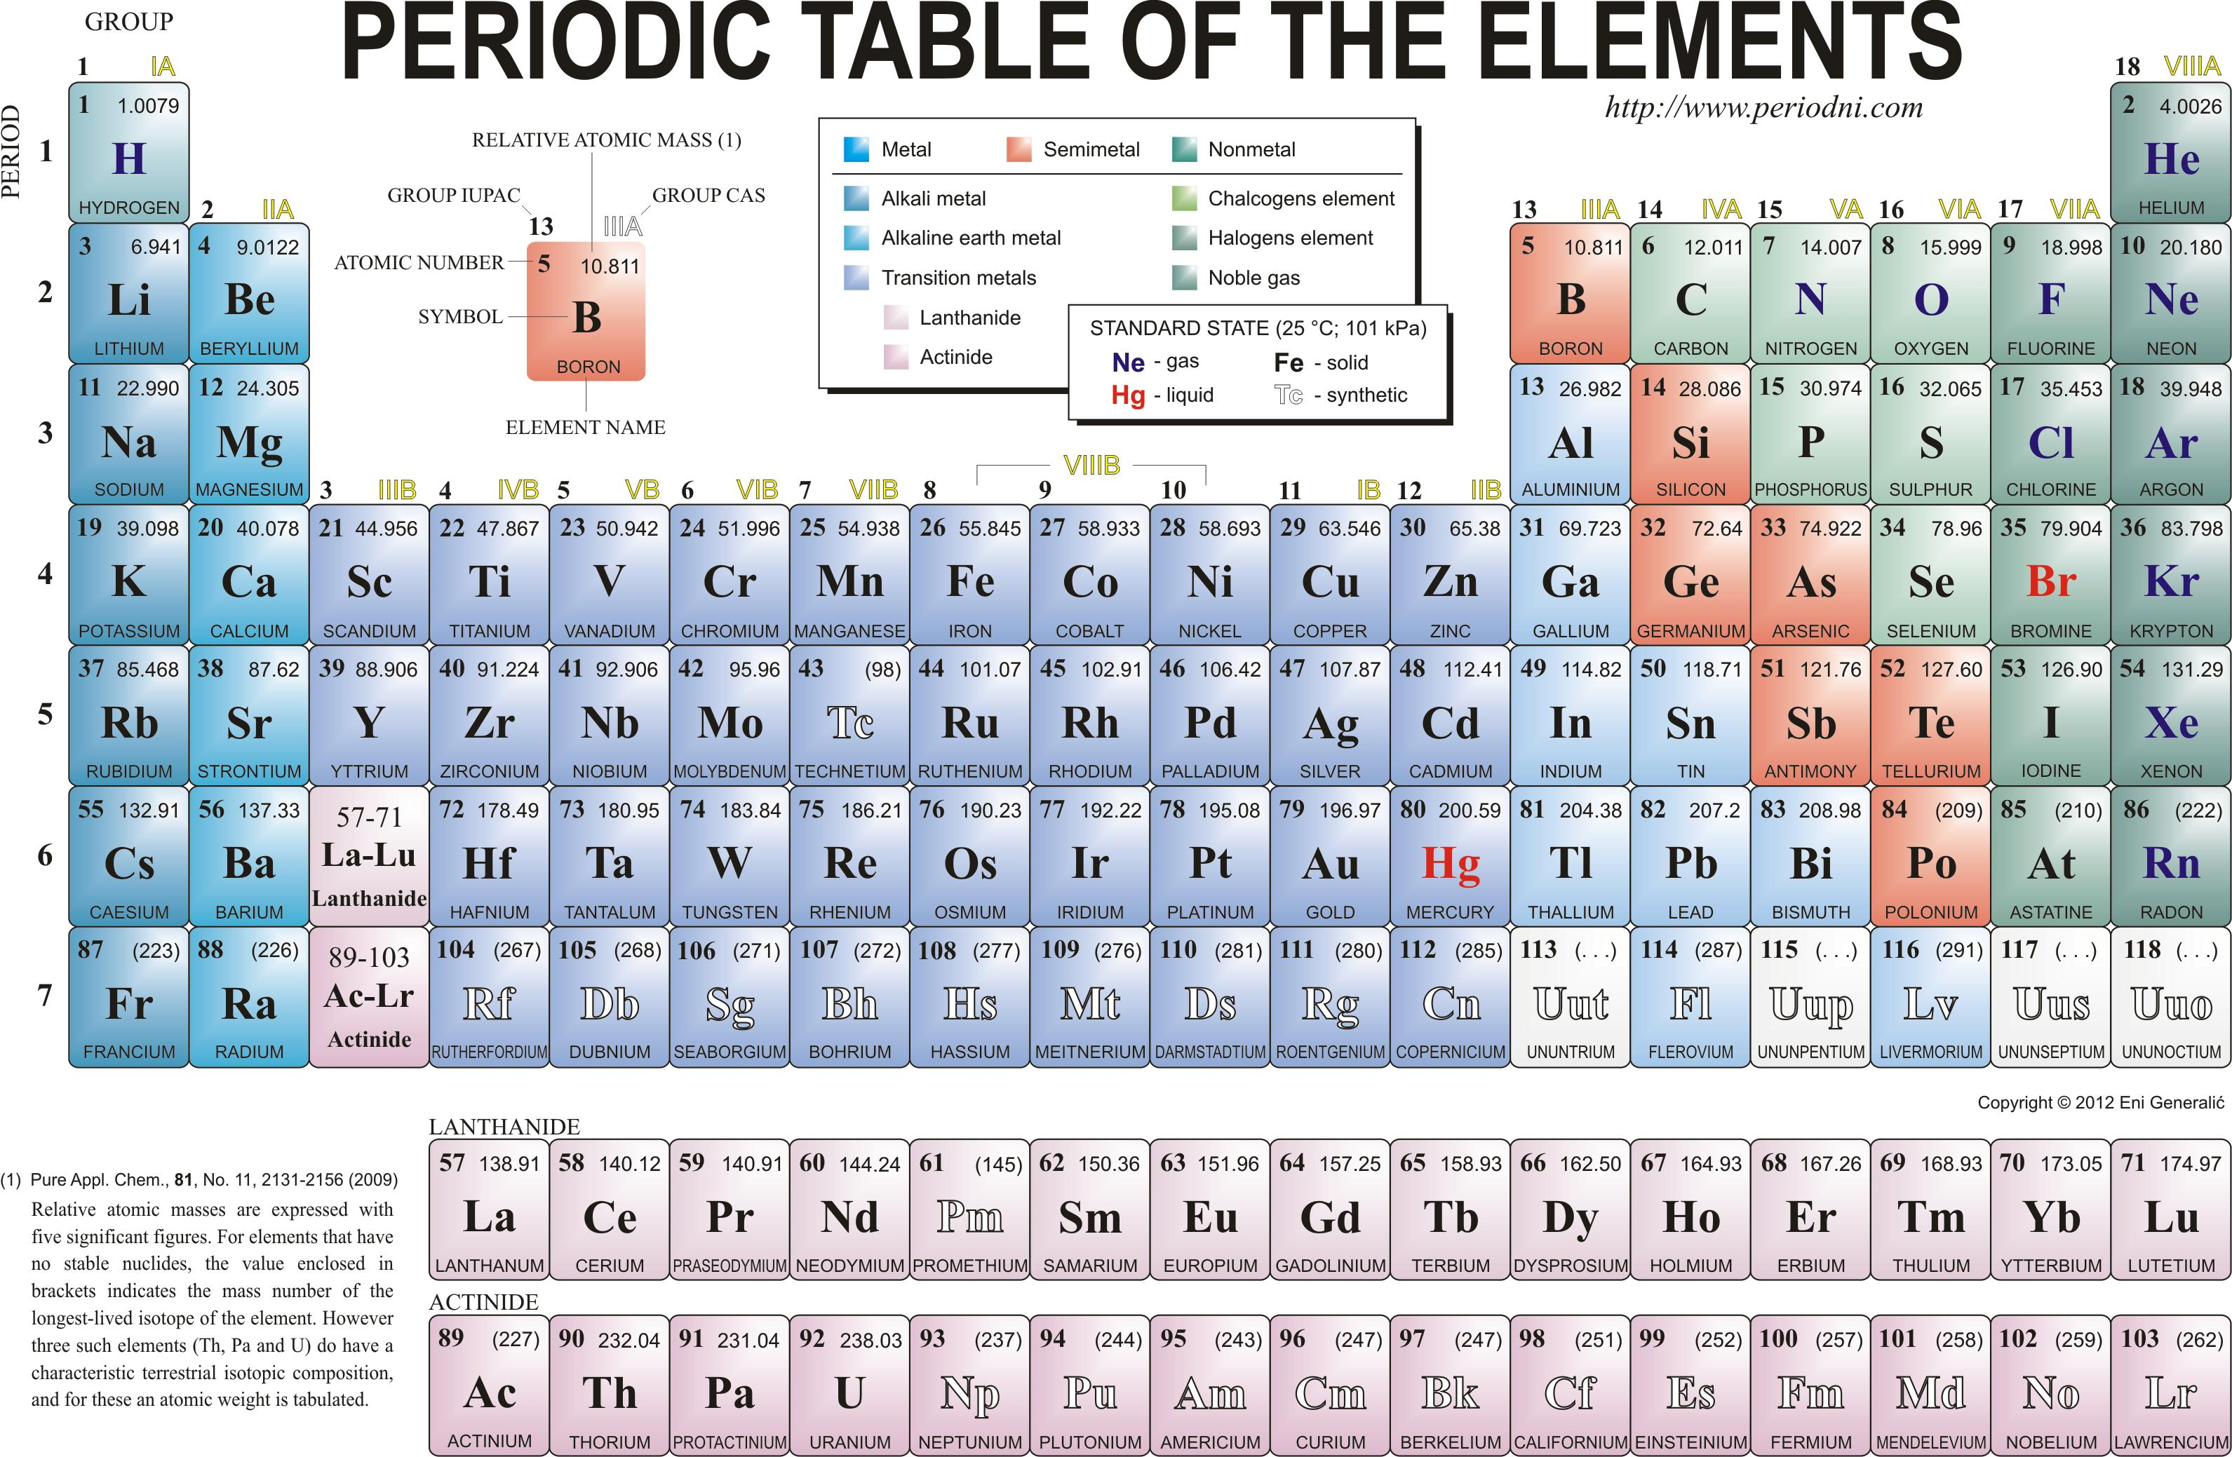

Slide 4
Basic Quantum Theory
Learning Outcomes
• After completing this chapter, students should be able to:
Explain the main features of the quantum chemical picture of an atom.
Relate atomic spectra to important advance in quantum theory.
Distinguish the wave nature of an electron.
Show the shapes of orbitals.
Classify the quantum numbers.
Write the electron configurations of atoms.

Slide 5
Chapter Outline
Subatomic Particles
Fundamental Particles
The Discovery of Electrons
Canal Rays and Protons
Rutherford and the Nuclear Atom
Atomic Number
Neutrons
Mass Number and Isotopes
The Atomic Weight Scale and Atomic Weights

Slide 6
Fundamental Particles
Three fundamental particles make up atoms. The following table lists these particles together with their masses and their charges.
Particle Mass (amu) Charge
Electron (e⁻) 0.00054858 -1
Proton (p,p⁺) 1.0073 +1
Neutron(n,n⁰) 1.0087 0

Slide 7
Dalton’s Atomic Theory
Beginning of 19th century John Dalton set down following principles known as
(Dalton's atomic theory of matter).
Matter is made up of indivisible and indestructible particles called atoms.
An element is made up of only one kind of atom, having the same size, mass and chemical properties.
Compounds are made up of atoms of two or more elements, chemically combined in fixed proportions.
Chemical reactions involve only the separation, combination or rearrangement of atoms; they do not result in their creation or destruction. (law of conservation of mass)

Slide 8
Dalton’s Atomic Theory
Elements are made of tiny particles called atoms.
All atoms of a given element are identical (not exactly; isotopes)
The atoms of a given element are different from those of any other element.
Atoms of one element can combine with atoms of other elements to form compounds. A given compound always has the same relative numbers and types of atoms.
Atoms are indivisible in chemical processes. That is, atoms are not created or destroyed in chemical reactions.
A chemical reaction simply changes the way the atoms are grouped together.

Slide 9
Dalton’s Postulates
All matter is composed of atoms
Atoms cannot be made or destroyed
All atoms of the same element are identical
Different elements have different types of atoms
Chemical reactions occur when atoms are rearranged
Compounds are formed from atoms of the constituent elements.
Dalton imagined atom as extremely small and indivisible but by 1850's investigations began to demonstrate that atoms possess internal structure.

Slide 10
Late 19th century J.J. Thomson used a cathode ray tube to obtain mass to charge ratio of an electron.
In 1908 Millikan determined charge of electron.
Rutherford proposed that all positive charges are concentrated in a central core called nucleus. (must have same number as electrons since atom is neutral).
In 1932 James Chadwick showed that there also existed neutral particles he called neutrons. (need to account for discrepancy in atomic mass of H and He)

Slide 11
The discovery of Electrons
Humphrey Davy in the early 1800’s passed electricity through compounds and noted and concluded that:
  the compounds decomposed into elements.
  compounds are held together by electrical forces.
Michael Faraday in 1832-1833 realized that the amount of reaction that occurs during electrolysis is proportional to the electrical current passed through the compounds.
Cathode Ray Tubes experiments performed in the late 1800’s & early 1900’s.
  Consist of two electrodes sealed in a glass tube containing a gas at very low pressure.
  When a voltage is applied to the cathodes a glow discharge is emitted.

Slide 12
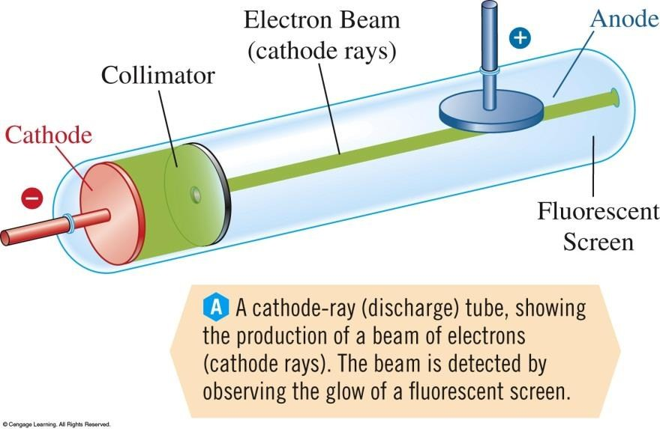
Figure 1: These ―rays are emitted from cathode (- end) and travel to anode (+ end). Cathode Rays must be negatively charged!

Slide 13
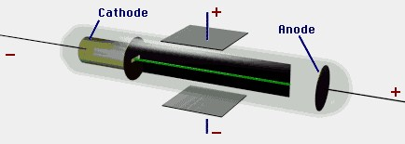
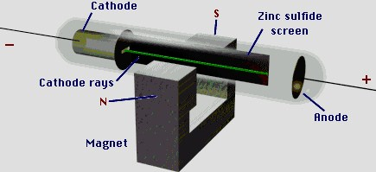

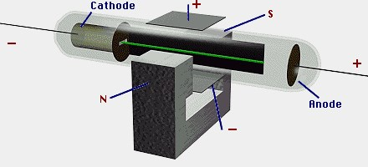
J.J. Thomson modified the cathode ray tube experiments in 1897 by adding two adjustable voltage electrodes. Studied the amount that the cathode ray beam was deflected by additional electric field.  Modifications to the basic cathode ray tube experiment.
Figure 2

Slide 14
Thomson used his modification to measure the charge to mass ratio of electrons
Charge to mass ratio e/m = -1.75882 x 10⁸ coulomb/g .
Thomson named the cathode rays electrons. Thomson is considered to be the (discoverer of electrons).
TV sets and computer screens are cathode ray tubes.
Robert A. Milikan won the Nobel Prize in 1923for his famous oil-drop experiment.
In 1909 Milikan determined the charge and mass of the electron.

Slide 15
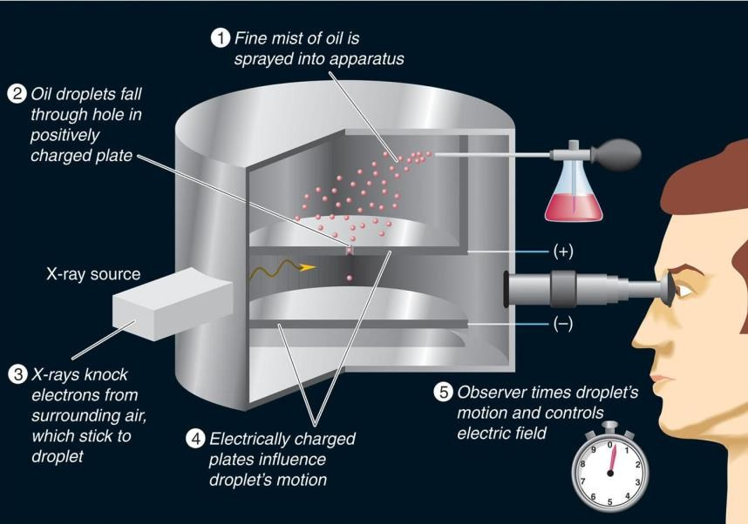
Millikan determined that the charge on a single electron = -1.60218 x 10⁻¹⁹ coulomb.
Using Thomson’s charge to mass ratio we get that the mass of one electron is 9.11 x 10⁻²⁸ g.
  e/m = -1.75882 x 10⁸ coulomb
  e = -1.60218 x 10⁻¹⁹ coulomb
  m = 9.10940 x 10⁻²⁸ g

Slide 16
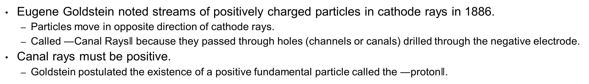
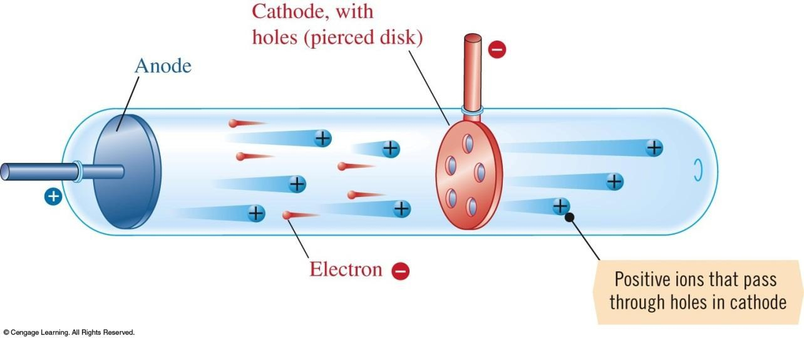
  Canal Rays and Protons

Slide 17
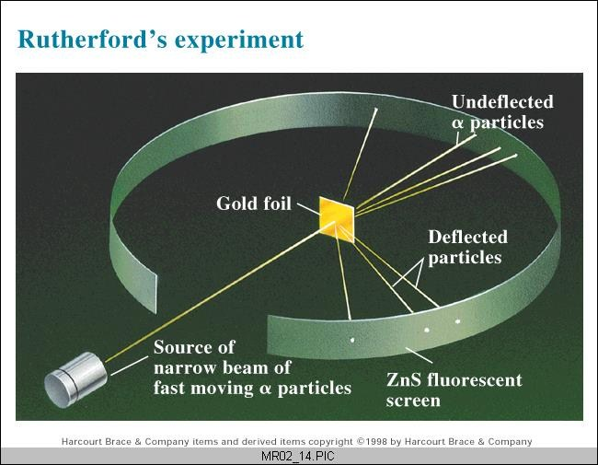
Rutherford and the Nuclear Atom
Ernest Rutherford directed Hans Geiger and Ernst Marsden’s experiment in 1910.
α- particle scattering from thin Au foils
Gave us the basic picture of the atom’s structure.
http://www.youtube.com/watch?v=5pZj0u_XMbc
In 1912 Rutherford decoded the α-particle
scattering information.
Explanation involved a nuclear atom with
electrons surrounding the nucleus.

Slide 18
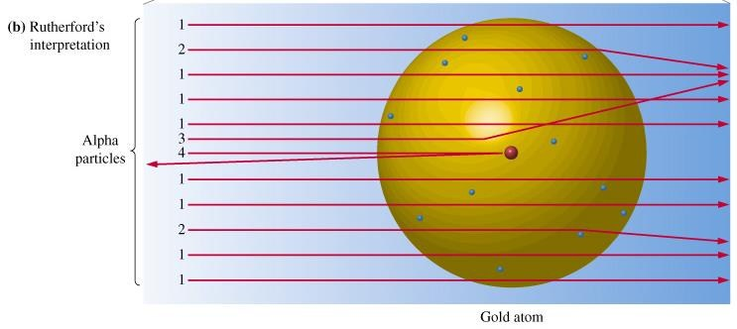
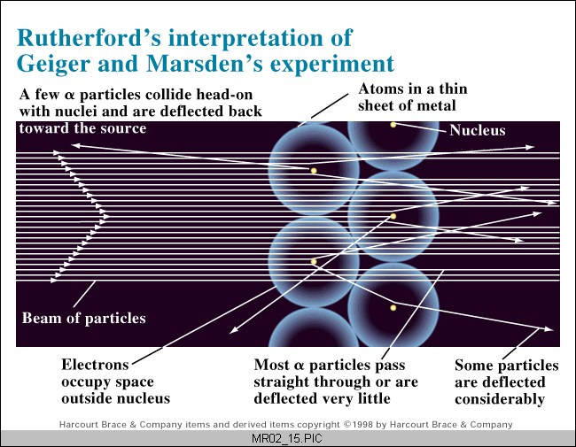

Slide 19
Rutherford’s major conclusions from the α-particle scattering experiment:
The atom is mostly empty space.
It contains a very small, dense center called the nucleus.
3. Nearly all of the atom’s mass is in the nucleus.
4. The nuclear diameter is 1/10,000 to 1/100,000 times less than atom’s radius.

Slide 20
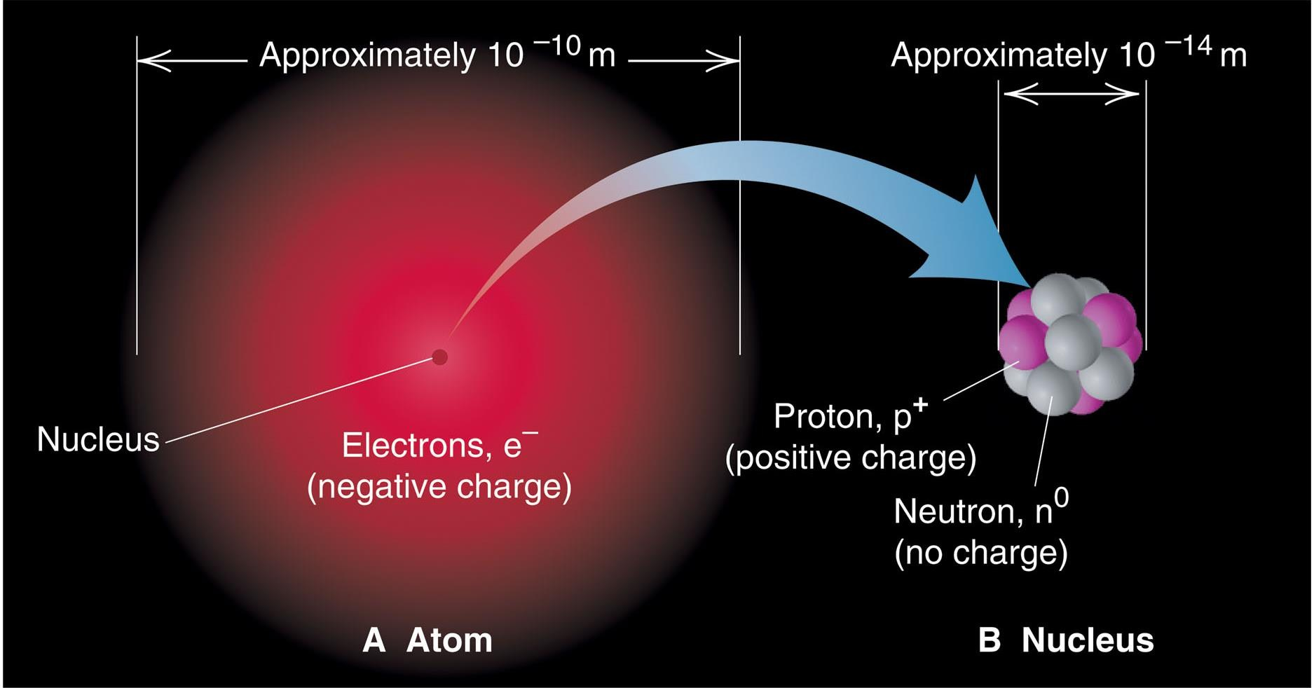
General features of the atom today.
The atom is an electrically neutral, spherical
entity composed of a positively charged central
nucleus surrounded by one or more negatively
charge electrons.
The atomic nucleus consists of protons and
neutrons.

Slide 21
Neutrons
James Chadwick in 1932 analyzed the results of α-particle scattering on thin Be films.
Chadwick recognized existence of massive neutral particles which he called neutrons.
Chadwick discovered the neutron.
Atomic number and elements
Recall – an element is a substance that cannot be broken down into simpler substances by chemical reactions
All atoms of a given element have the same atomic number (number of protons), which determines the identity of the element
An elements identity comes from the number of protons in its nucleus
.

Slide 22
Atomic Number
The atomic number is equal to the number of protons in the nucleus.
  Sometimes given the symbol Z.
In 1913 H.G.J. Moseley realized that the atomic number determines the element .
  The elements differ from each other by the number of protons in the nucleus.
  The number of electrons in a neutral atom is also equal to the atomic number.

Slide 24

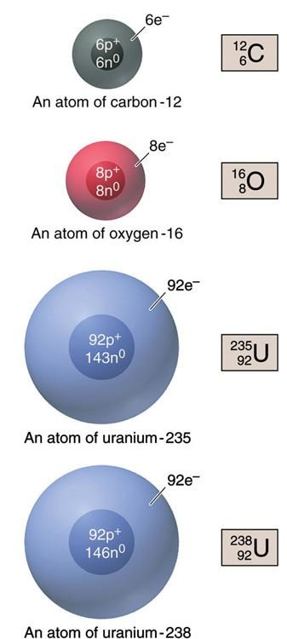
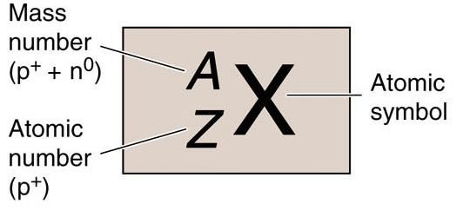
Mass Number (A) = no. of protons + no.. of Neutrons
Atomic Number (Z)= no. of protons = no. of electrons

Slide 25
Example \ How many protons, neutrons and electrons are found in an atom of
133 35 37
Cs Cl Cl
55 17 17
Isotopes
Isotopes are atoms that have the same number of protons—the same atomic number—but different numbers of neutrons—different mass numbers.
Dalton thought all atoms of the same element would have the same mass, but experimental observations showed that all atoms of the same element have the same atomic number

Slide 26
Mass Number and Isotopes
One example of an isotopic series is the hydrogen isotopes.
¹H or protium is the most common hydrogen isotope. (one proton and no neutrons).
²H or deuterium is the second most abundant hydrogen isotope. (one proton and one neutron)
³H or tritium is a radioactive hydrogen isotope. (one proton and two neutrons).
– All hydrogen atoms have 1 proton (atomic number 1) – Some have a neutrons in the nucleus

Slide 27
Mass Number and Isotopes
The stable oxygen isotopes provide another example.
¹⁶O is the most abundant stable O isotope.
How many protons and neutrons are in ¹⁶O? 8 protons and 8 neutrons
¹⁷O is the least abundant stable O isotope.
How many protons and neutrons are in ¹⁷O? 8 protons and 9 neutrons
¹⁸O is the second most abundant stable O isotope.
How many protons and neutrons in ¹⁸O? 8 protons and 10 neutrons
Most elements exist in nature as a mixture of isotopes.
The atomic mass of an element is the average of all the atomic masses of the isotopes.
an isotopes contribution is determined by its relative abundance.

Slide 28
The Atomic Weight Scale and Atomic Weights
If we define the mass of ¹²C as exactly 12 atomic mass units (amu), then it is possible to establish a relative weight scale for atoms.
– 1 amu = (1/12) mass of ¹²C by definition – What is the mass of an amu in grams?
Example 1-1: Calculate the number of atomic mass units in one gram.
The mass of one ³¹P atom has been experimentally determined to be 30.99376 amu.
1 mol of ³¹P atoms has a mass of 30.99376 g.
( 1g ) * ( 6.0233* 10²³ ³¹P atom / 30.99376 g ) ( 30.99376 amu / ³¹P atom )
= 6.022 * 10²³ amu
Thus 1.00 g = 6.022 x 10²³ amu
This is always true and provides the conversion factor between grams and amu.

Slide 29
Atomic Weights
The atomic weight of an element is the weighted average of the masses of its stable isotopes.
Example 1-2: Naturally occurring Cu consists of 2 isotopes. It is 69.1% Cu with a mass of 62.9 amu, and 30.9% ⁶⁵Cu, which has a mass of 64.9 amu.. Calculate the atomic weight of Cu to one decimal place.
atomic weight = (0.691)(62.9 amu) + (0.309)(64.9 amu)
Atomic weight = 63.5 amu for cupper
Example 1-3: Naturally occurring chromium consists of four isotopes. It is 4.31% ⁵⁰Cr, mass = 49.946 amu, 83.76% ⁵²Cr, mass = 51.941 amu, 9.55% ⁵³Cr, mass = 52.941 amu, and 2.38% ⁵⁴Cr, mass = 53.939 amu. Calculate the atomic weight of chromium.
You do it!
Example 1-4: The atomic weight of boron is 10.811 amu. The masses of the two naturally occurring isotops 10B and 11B are 10.013 and 11.009 amu, respectively. Calculate the fraction and percentage of each isotope
You do it!

Slide 30
The problem requires a little algebra.
A hint for this problem is X + (1-X)=1.
Note that because x is the multiplier for the ¹⁰B isotope, our solution gives us the fraction of natural B that is ¹⁰B.
Fraction of ¹⁰B = 0.199 and % abundance of ¹⁰B = 19.9%.
The multiplier for ¹¹B is (1-x) thus the fraction of ¹¹B is 1-0.199 = 0.801 and the % abundance of ¹¹B is 80.1%.

Slide 31
THANK YOU VERY MUCH

